Slide 1
Builder Pattern

Slide 2
Builder Pattern
A creational design pattern that lets you produce different types and representations of an object using the same building process. Builder allows constructing complex objects step by step.

Slide 3
Intent
Separate the construction of a complex object from its representation so that you can use the same construction process for different types of objects.
Parse a complex representation and create one of several target objets out of it.

Slide 4
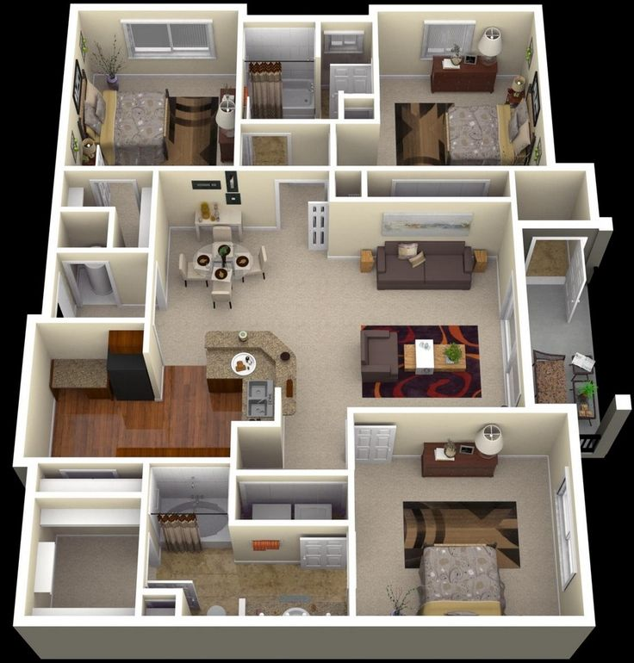
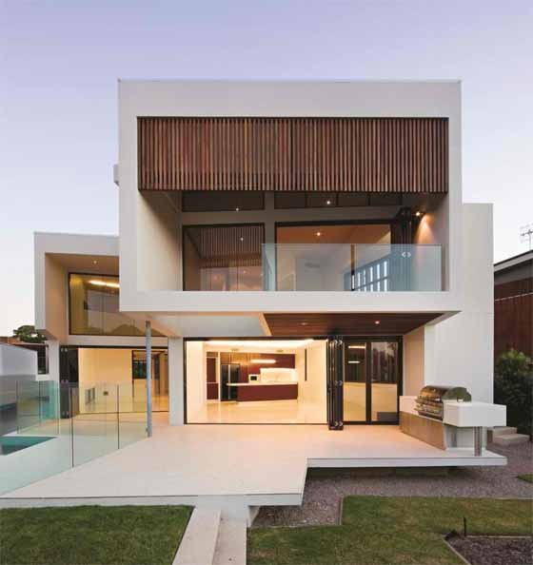

Build a house

Slide 5
Benefits
Ideal of construction process occurs in a number of discrete steps
Strict separation between data representation and the construction process.
Convenient when a single product can be represented by several representations
Offers fine-grained control over construction process

Slide 6
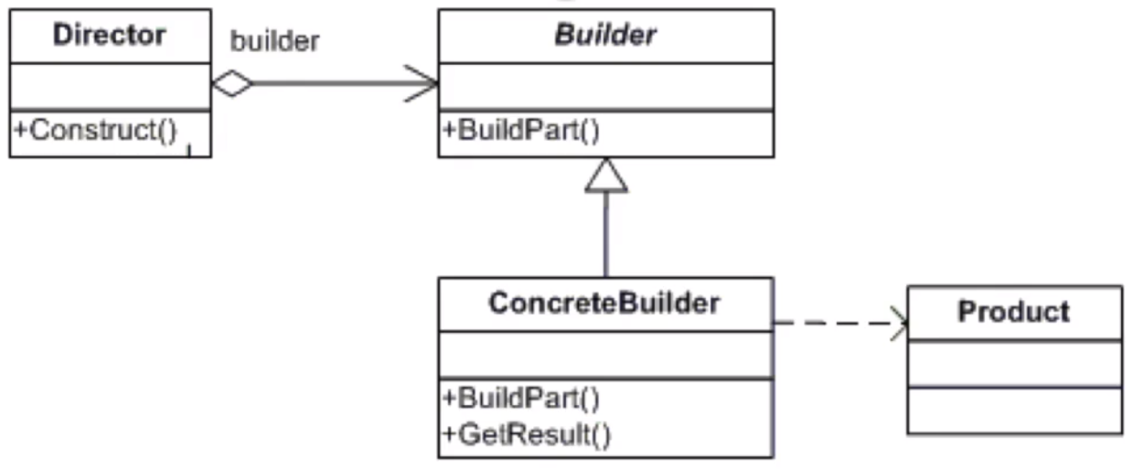
UMl

Slide 7
How to implement
Make sure that you have the common steps of building the product, as well as variations of the steps that lead to the creation of various representations of products.
Create the Builder interface (or abstract class) and declare production steps in it.
Create a Concrete Builder class for each of the product representations. Implement their construction steps.
Think about creating a Director class. Its methods should create different product configurations, using different steps of the same builder instance.
The client code creates both Builder and Director objects. It creates a builder instance first and then passes it either to the director's constructor or its production methods.
The client should call a production method of a Director object to begin the construction process.
The result can be obtained from the Director object only if all products have a common interface. In the opposite case, each Builder must have its own method of retrieving the result.

Slide 8
Checklist
Define a director that calls the builder methods in the correct order.
Make sure the client does not use NEW anywhere and only uses the builder to create new instances.

Slide 9
Comments
You can also use a prototype or factory pattern to create the parts
The builder pattern is especially useful to create composite objets
You can refactor a Factory Method pattern into a Builder as your code gets more complex

Slide 10
Applicability
When you have a "telescopic" constructor.
A constructor with a dozen of optional parameters is not convenient to call. You have to specify all of the parameters, even if you do not need them.
To ease the pain, one can overload a long constructor and create several shorter versions with fewer parameters. They will still call the main constructor, but pass some default values into omitted parameters.
The Builder pattern allows building objects step by step. Moreover, you can use only required steps and skip the optional ones when building a simple object.
When your code has to create different representations of one product (for example, stone and wooden houses). Construction of the product has similar steps that differ in details. Plus, although the products may be similar, they do not necessary have to have a common base class or interface.
Builder can be used to construct different products using the same building process.
Each distinct product will be represented by a separate builder class. Code that controls the construction order may live in a single director class.
When you have to build a Composite tree or another complex object.
Builder constructs products steps by step. It allows deferred or even recursive building that is mandatory when you are working with tree structures. Builder does not expose unfinished product while running construction steps. This prevents client code from getting corrupted results.

